Slide 1
Woodland Public Schools
Facilities and Safety Report
October 2018

Slide 2
FACILITIES REPORT
Continued
Radon Testing
A new policy and procedure document has been drafted. Initial testing was started at the Middle School and includes 5 sample points in the Green Hall, Yellow Hall and Portable classrooms. Initial sampling will include approximately 15% of the classrooms at each campus. After initial sampling is completed, additional testing will include all regularly occupied classrooms and common spaces at each school. The samples’ results are expressed in pico-curies per liter (pCi/l). The action level for high readings (≤4 pCi/l) will be to retest the space, and if the additional testing also confirms high levels, action will be taken to mitigate the problem. Readings thus far, have been well below the trigger point and have averaged around .2 to .3 pCi/l.
No Parking Signs
The new “No Parking” signs were installed on Robinson Road on Monday, 11/19. The signs identify the area, from the roundabout on the north of the road to the entrance of the school on the east side, as no parking areas from 7:30AM to 4:30PM. This action will provide unlimited visibility for both buses and other vehicle traffic during school hours.

Slide 3
(Continued)
FACILITIES REPORT
Yale Chlorination
Initial plans have been drafted and are being reviewed for submittal to the Health Department for permitting. I would expect this to be submitted to the County before the Christmas break. After the review process, we will install a small doghouse over the well head for the necessary metering equipment and electrical service. I would expect the electrical and mechanical work to be completed approximately 30 days after permits are received.
WMS Trees on Buckeye
We are making final arrangements for the trees to be planted along Buckeye Street. A subcontractor will be installing these. As mentioned before, the balance of the Pin Oak trees that were lifting sidewalks and blacktop along the north side of WMS will be removed this next summer, when the new Celebration Maples bloom.
Turkey Day Maintenance
Along with the deep clean and normal deep cleaning activities, a few projects will be completed during the Turkey Day week, including a reconfiguration of the of the PBIS room at the Intermediate School, finishing the exterior work on portable 11/12 at WPS, and the installation of two projector systems in the WMS Library and Art Room.

Slide 4
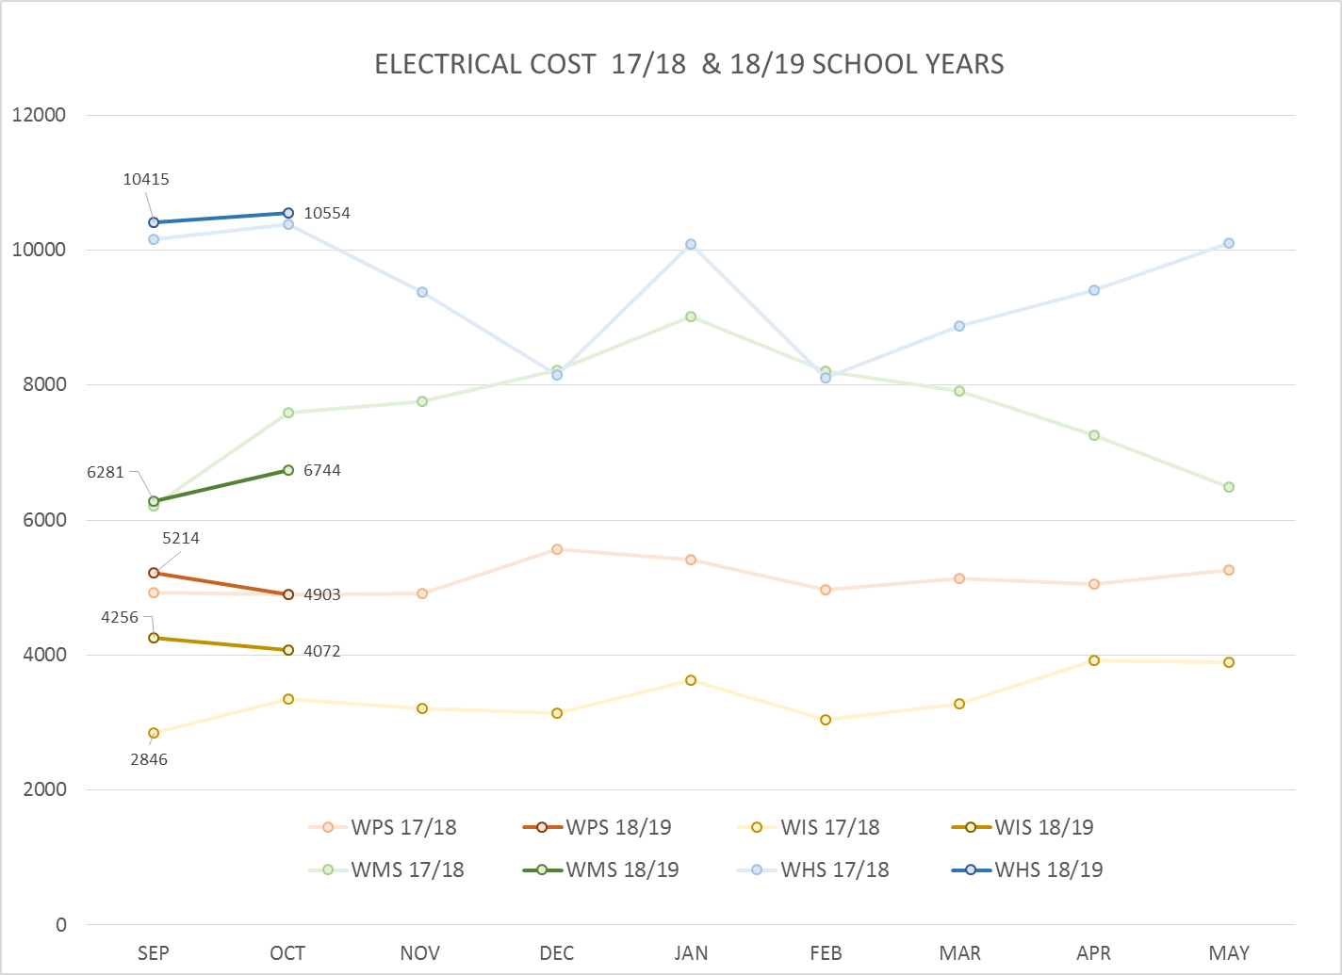
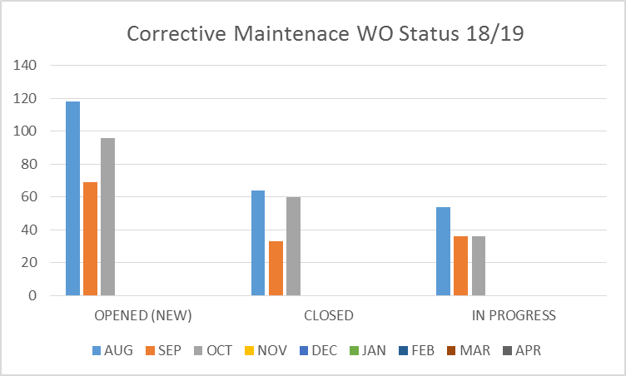
FACILITY CHARTS – POWER COST AND WORK ORDER STATUS

Slide 5
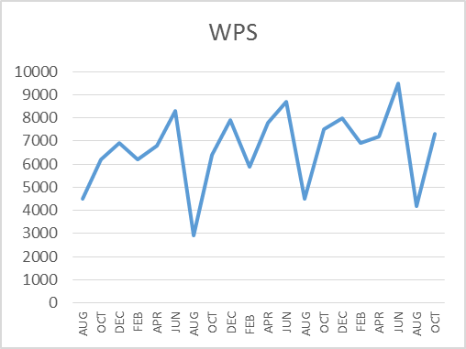
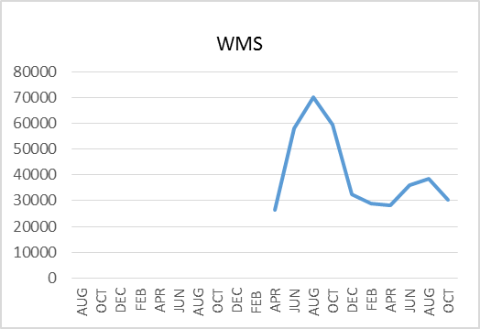
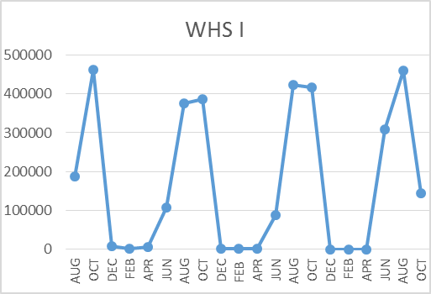
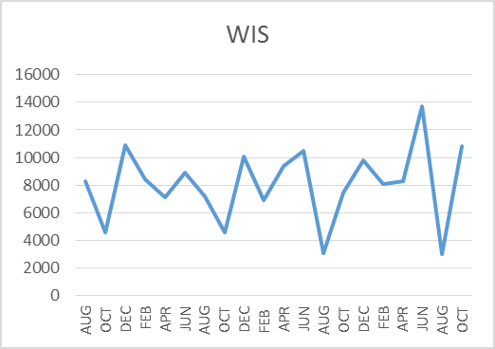
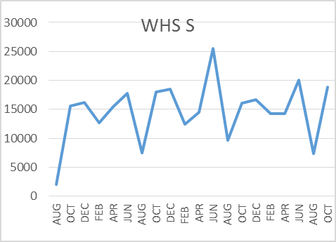
FACILITY CHARTS – WATER USAGE WHS, WIS, WMS, WPS
Note
Water charts are updated every two
months. Next update to these charts
in January, 2019.
The WMS chart has been reconfigured to include the following 7 meters: 755 Park high and low flow, BO and Team High, PIT house, bus barn, athletic field and DO. All of these meters are totaled on the WMS graph, but each data point is recorded separately to aid in identifying leaks.

Slide 6
SAFETY CHARTS
Accidents for the Month
There were 16 accidents/incidents for the month; 5 students and 11 staff.
Staff Accidents/Incidents
There were 9 staff incidents as the result of student behavior; 1 at WIS and 8 at WPS. Most injuries were the result of biting, kicking, punching or throwing of objects.
WIS employee turned too quickly lost balance and fell, hit head.
WIS staff slipped on wet step, bruised elbow.
Student Accidents/Injuries
WPS – Student broke arm after being pushed down.
WPS – Student fell from swing injuring elbow.
WIS – Student fell on arm during recess, fractured.
WHS - Students received minor burn in left hand from newly welded metal.
WHS –Student chipped bone during football game.

Slide 7
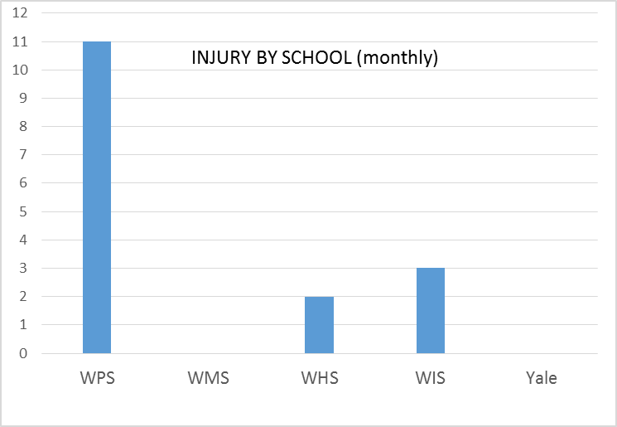
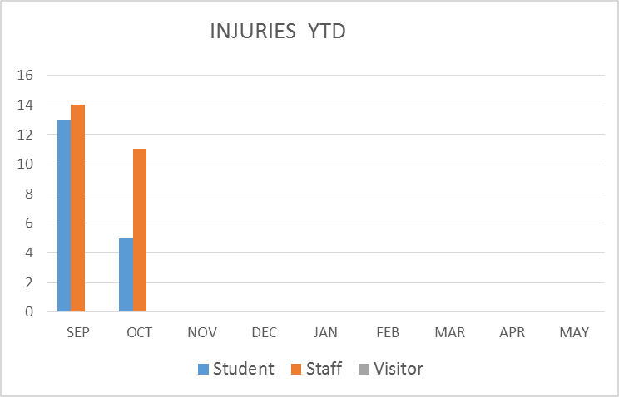
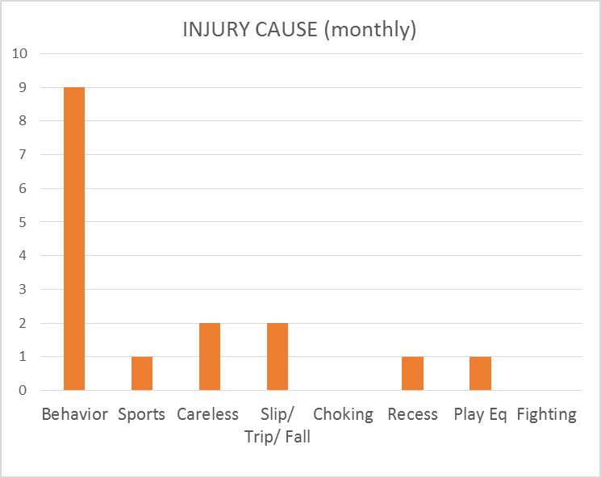
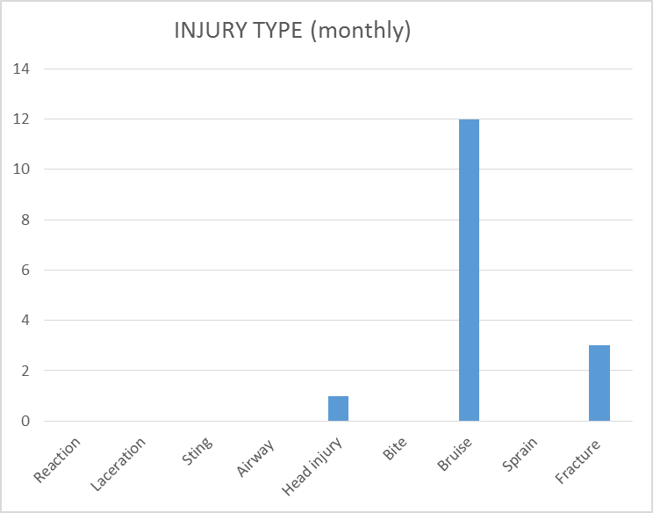
SAFETY CHARTS

